Slide 1
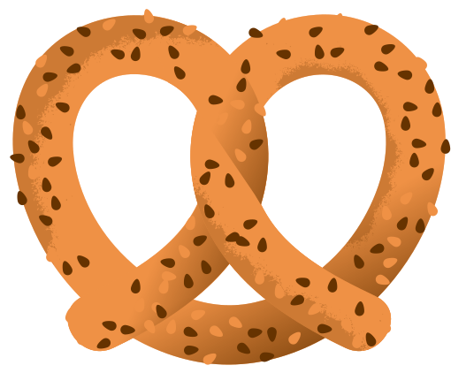
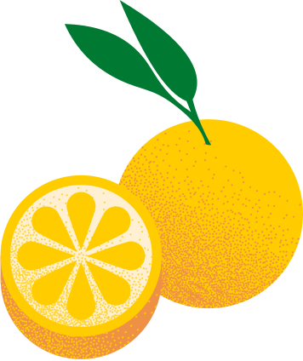

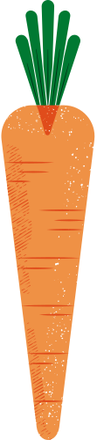

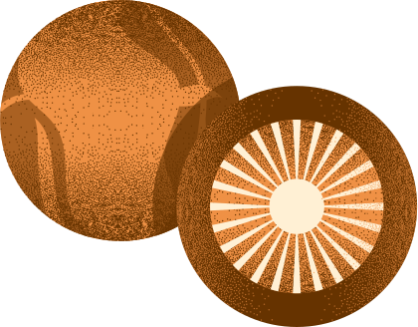
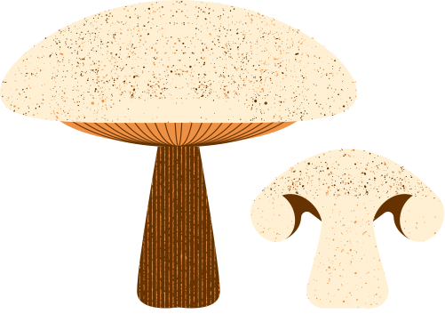
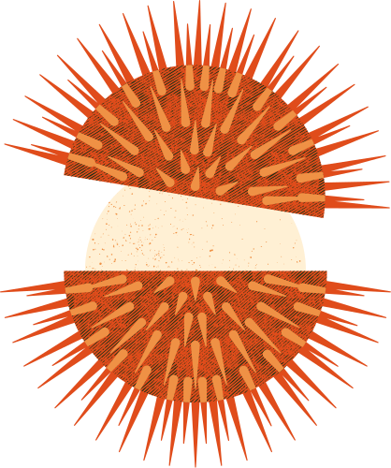
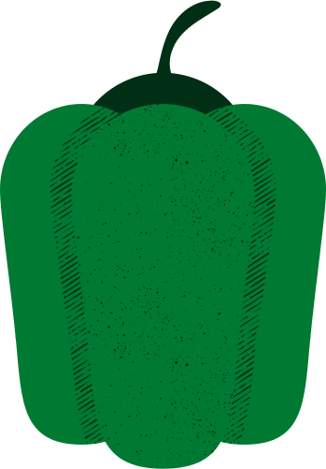
Vegetable Classification
Identifying images

Slide 2
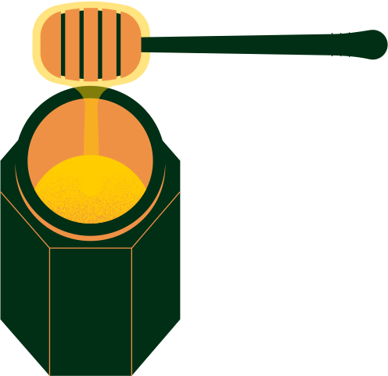
Background research
DATASETS
DCNN
Vegnet Dataset, Kaggle dataset
Extensive research, their custom model achieved 92.1%
Advanced DCNN
Hybrid DCNN
Building on VGG to improve convergence rate
Attention-based CNNs

Slide 3
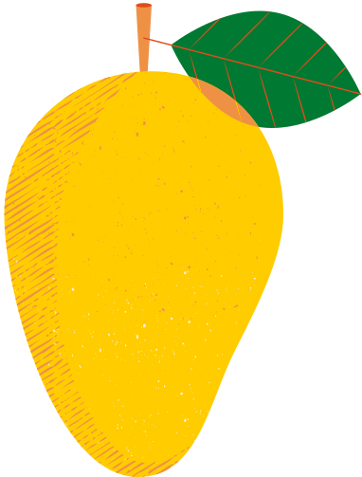
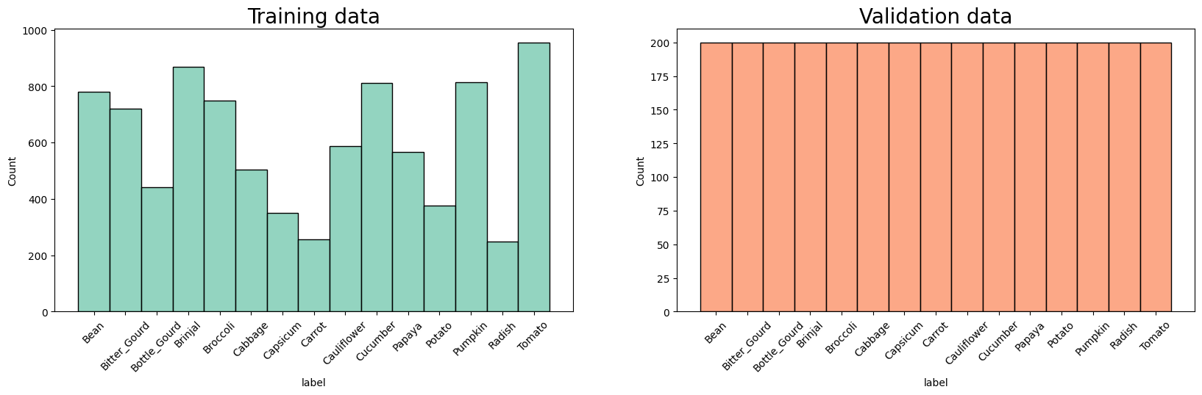
Number of samples

Slide 4
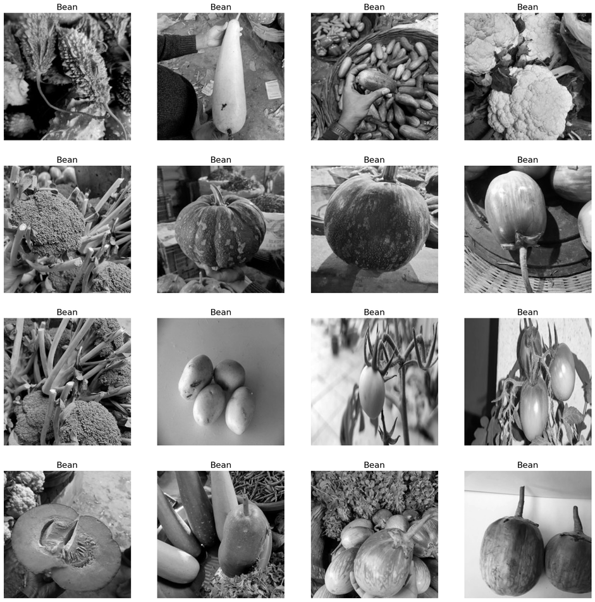
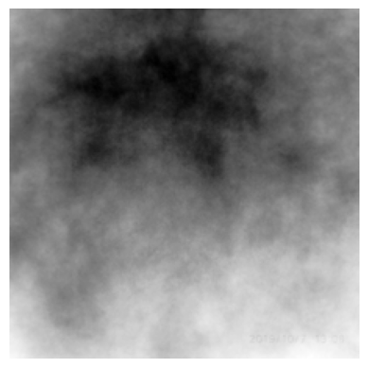
Visualize dataset
Image averaging

Slide 5
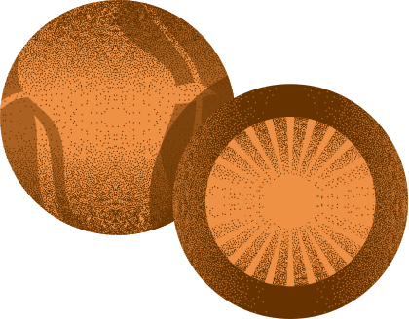
Data Preparation
Using SMOTE to oversample images to fix class imbalance
Using Under Sampling to fix class imbalance

Slide 6
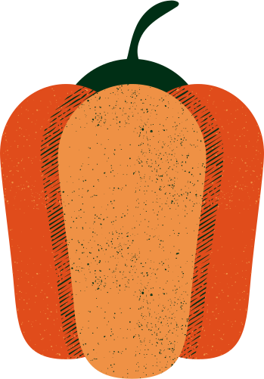
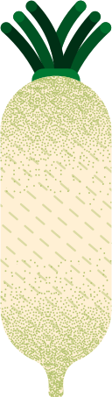
Rotation
Objects may not be exactly upright
Width Shift
Objects are not always centred, this simulates the left-right shift
Height Shift
Objects are not always centred, this simulates up-down shift
Zoom Range
Objects may be taken from different distances
Horizontal Flip
Images may be inverted.
Vertical Flip
Images may be flipped.
Brightness Range
Vegetables may be dimly lit.
Data Augmentation

Slide 7
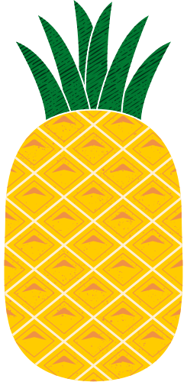
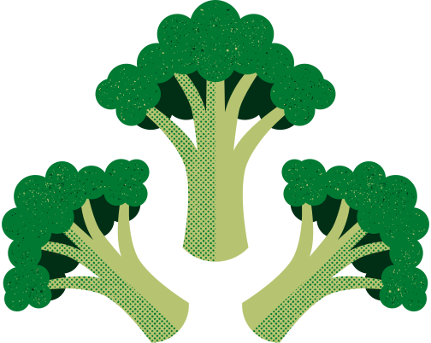
Adam vs SGD
Aspect | Adam | SGD
Speed | Faster due to adaptive learning rates | May be slower without proper tuning
Gradient Clipping | Utilizes coordinate-wise gradient clipping | May not inherently have gradient clipping
Learning Rate Adjustment | Adjusts learning rates individually for weights | Typically requires manual tuning of LR
Use Cases | Advantageous for NLP and some applications | Often preferred for image classification
Performance in Image Classification Tasks | May not be the preferred choice | Recognized for superior performance

Slide 8
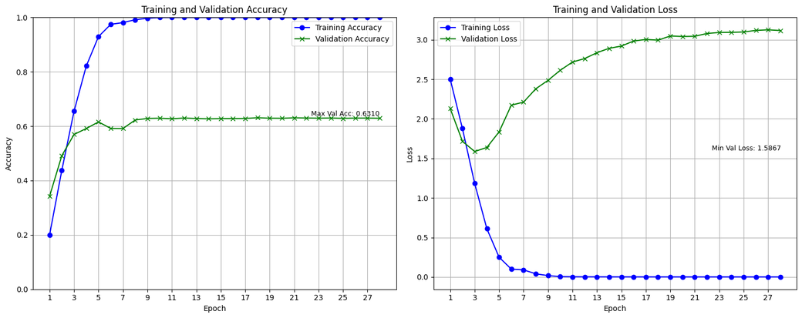
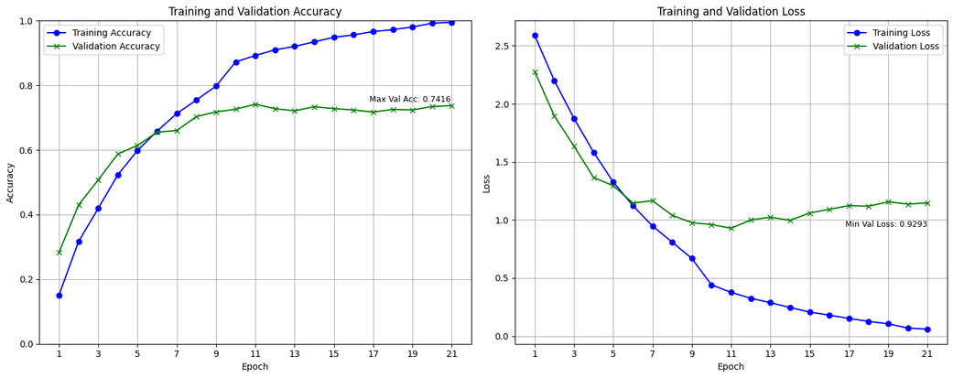
Base Model (oversampled)
128x128 image size
31x31 image size
Regularization, Data augmentation, Reviewing model architecture to address overfitting
Validation loss increased just after 3 epochs
Regularization, Data augmentation, Reviewing model architecture to address overfitting
Performs way better than 128x128

Slide 9
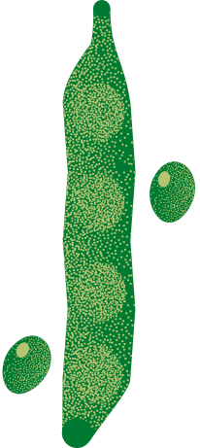
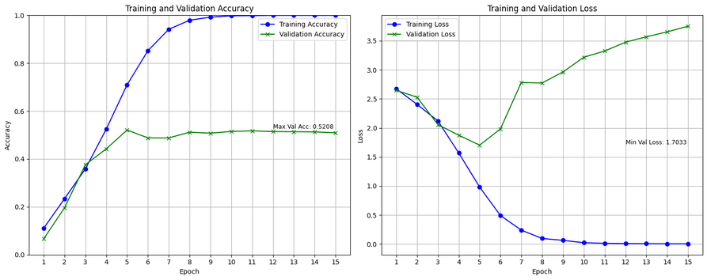
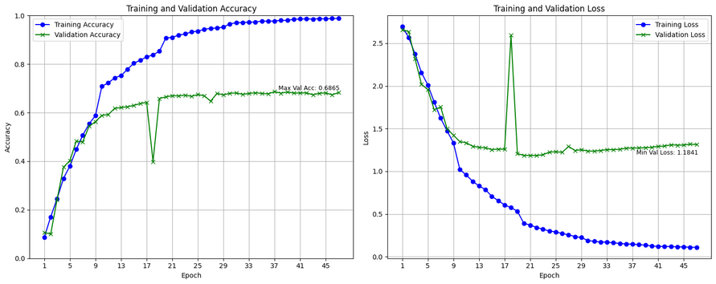
Base Model (undersampled)
128x128 image size
31x31 image size
Regularization, Data augmentation, Reviewing model architecture to address overfitting
Validation loss increased just after 5 epochs
Achieved similar results with oversampled data
Regularization, Data augmentation, Reviewing model architecture to address overfitting
Performs way better than 128x128
Validation accuracy is lower here than with oversampled data

Slide 10
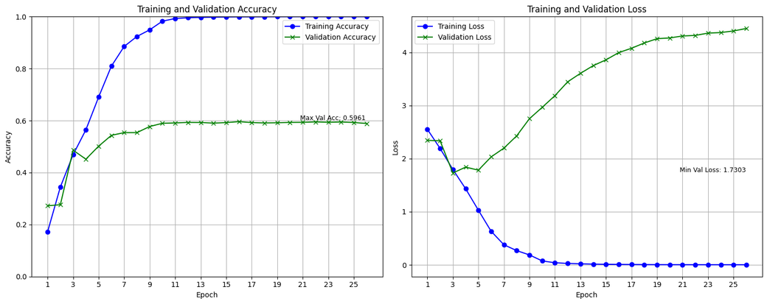
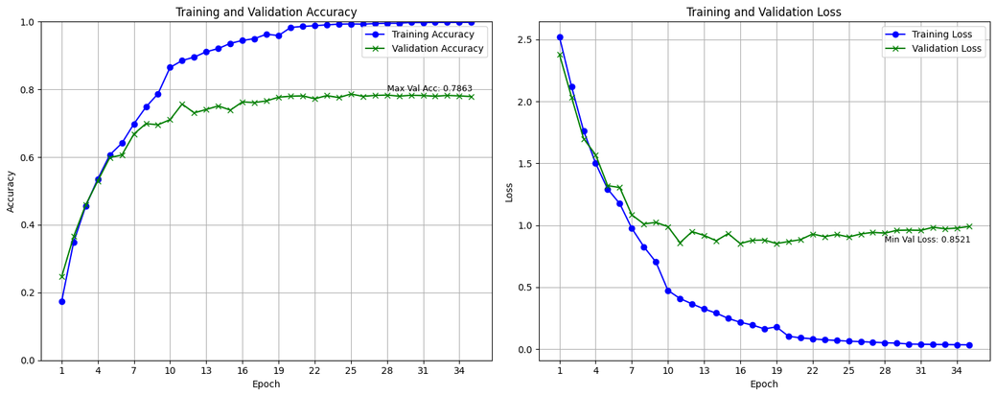
Base Model (imbalanced)
128x128 image size
31x31 image size
Low validation accuracy
High validation loss
Different sampling methods did not affect results much
Imbalanced data performed the best out of all the other sampling methods
Deep learning can handle imbalanced data

Slide 11
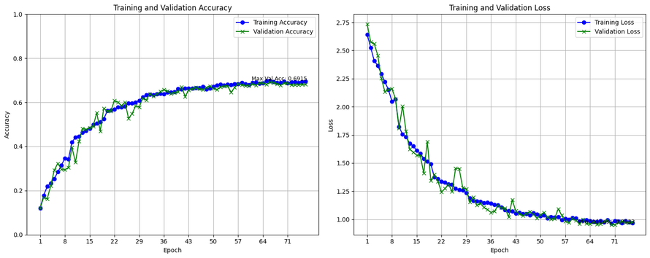
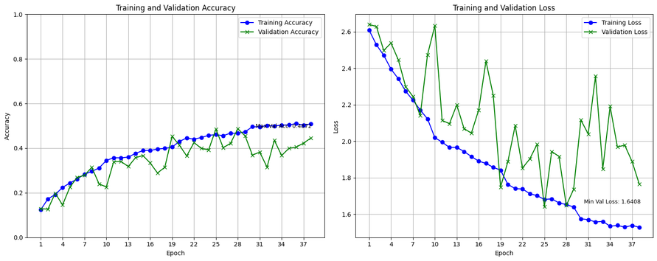
Base Model (augmentation)
128x128 image size
31x31 image size
Validation results follow training results very closely
Max validation stops improving after 69.2%
Validation accuracy becomes haphazard and is consistently below training accuracy
Validation accuracy is way lower with augmentation than without

Slide 12
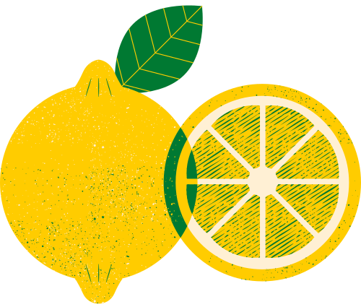
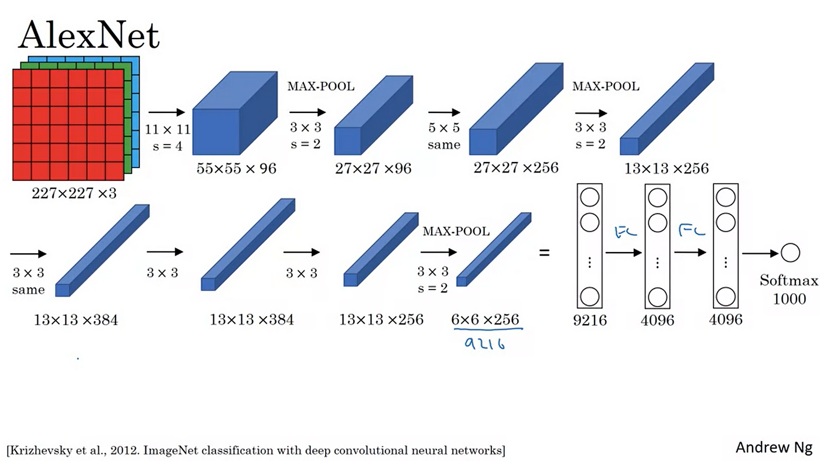
Adapted AlexNet
Large Kernel size
Originally trained on 227x227x3 image sizes
Hyperparameters have been adjusted

Slide 13
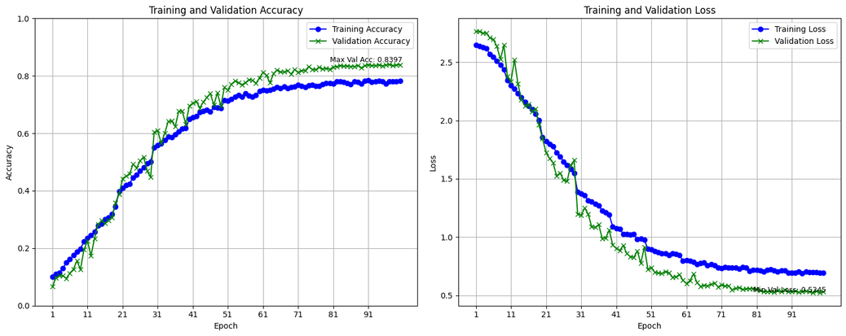
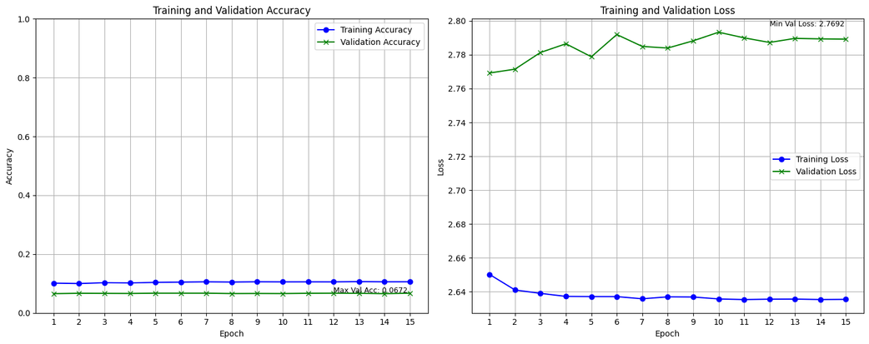
Adapted AlexNet
128x128 image size
31x31 image size
Augmented data
Validation results are consistently better than training results
Max Validation accuracy of 84%
Non augmented data
Accuracy and Loss did not improve
Model was unable to learn at all due to large kernel size

Slide 14
Adapted AlexNet
Takeaways
Large kernel sizes work for large images but not small images

Slide 15
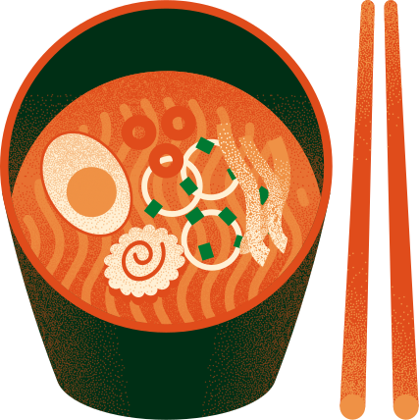
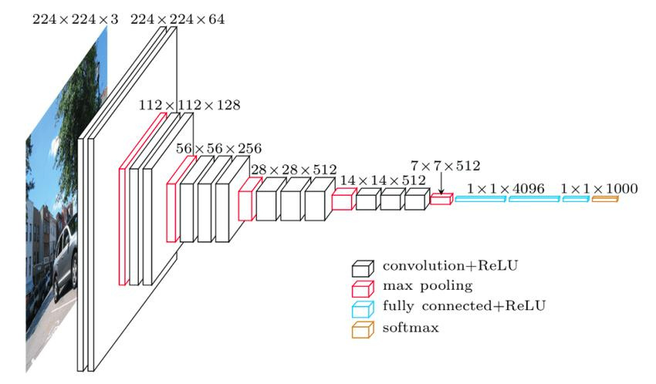
Adapted VGG
Replaces large kernel size
Originally trained on 224x224
Can work on smaller image sizes as well

Slide 16
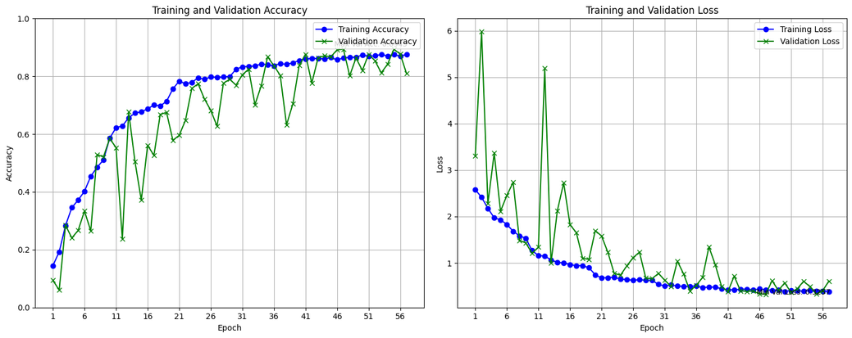
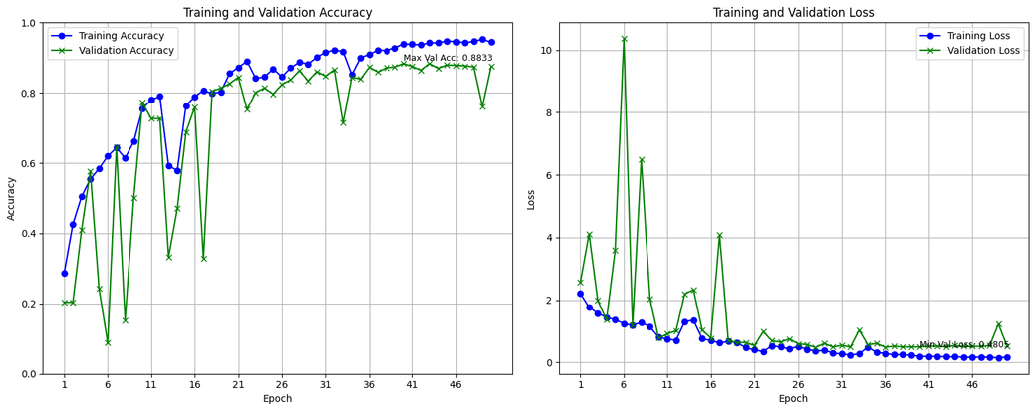
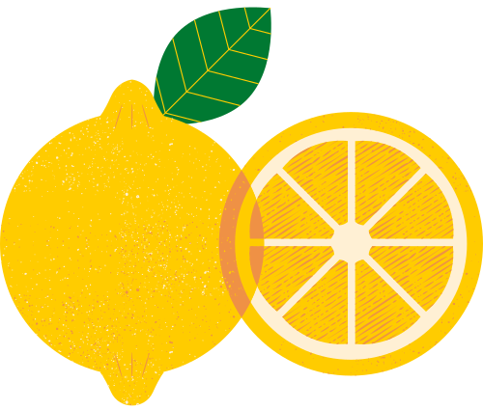
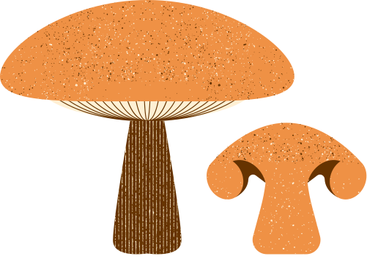
Adapted VGG
128x128 image size
31x31 image size
Augmented data
Validation results follow accuracy results
High max validation of 89%
Non augmented data
Validation results follow accuracy results
High max validation of 88.3%
Occasional abnormal decrease in validation accuracy

Slide 17
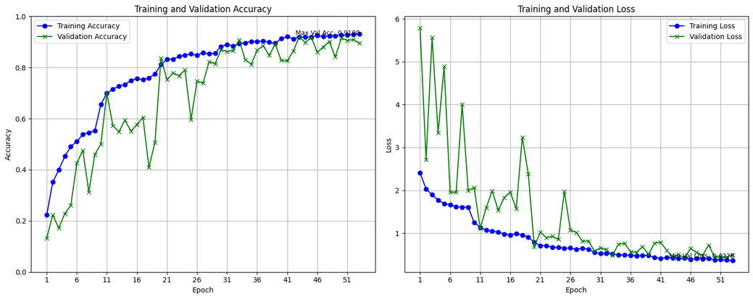
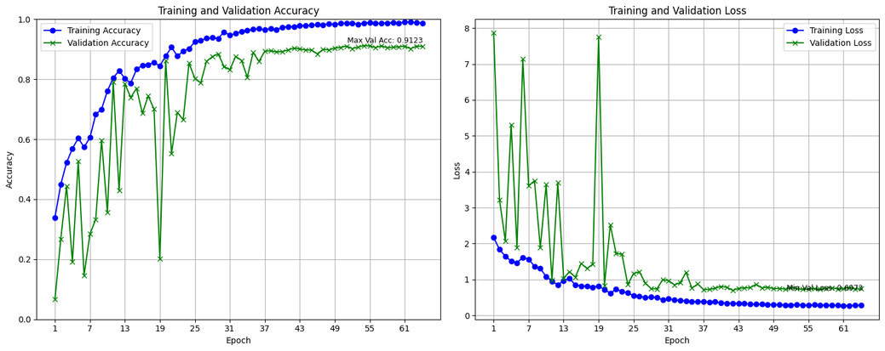
Adapted VGG with L2
128x128 image size
31x31 image size
Augmented data
Validation results closely follow accuracy results
Even higher max validation of 95.9%
High volatility before 25 epochs
Non augmented data
Validation results follow accuracy results
Even higher max validation of 91.2%
Fixed abnormal drops in val accuracy

Slide 18
Adapted VGG
Takeaways
Small kernel sizes can fit both large and small image sizes
Small kernels capture more details from images

Slide 19
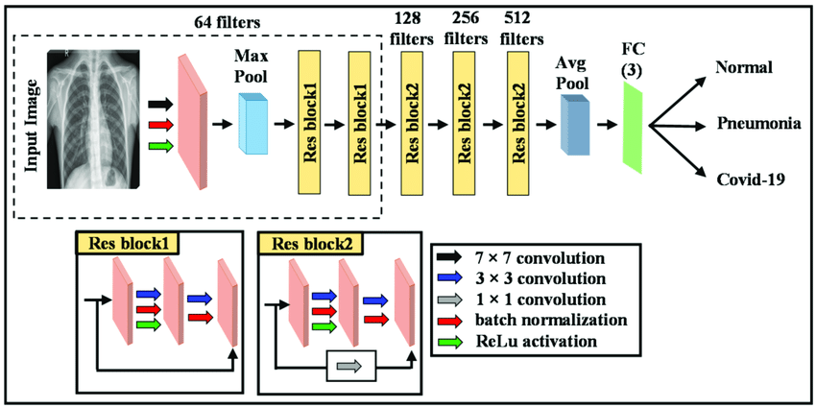
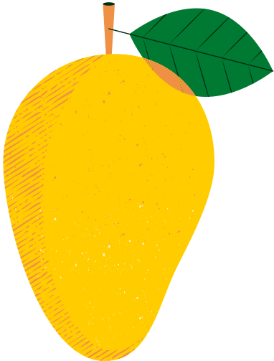
Adapted ResNet18
Introduction of Residual Blocks
ResNet18 was trained on 32x32 images

Slide 20
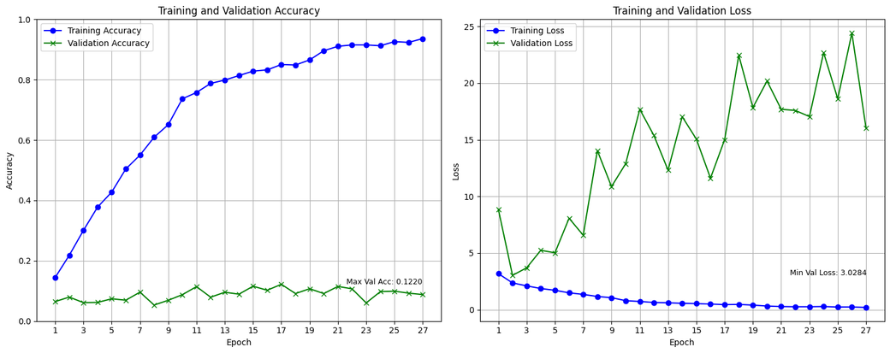
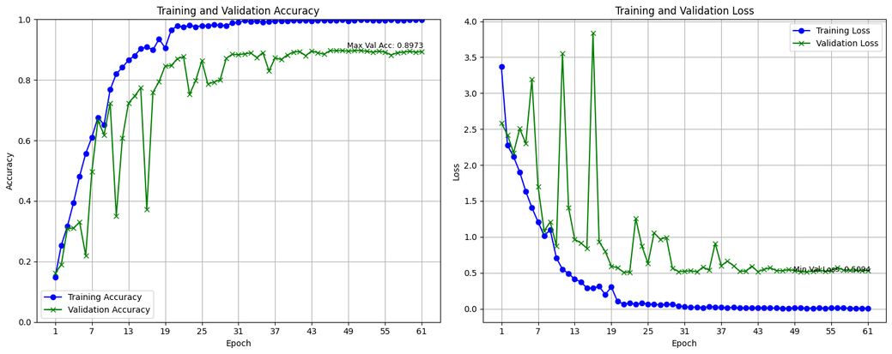
Adapted ResNet18
128x128 image size
31x31 image size
Augmented data
Validation accuracy did not improve
Images had too many details for the small model to generalize to
Non augmented data
Fits well to 31x31 image size
Results very similar to VGG
Requires regularization

Slide 21
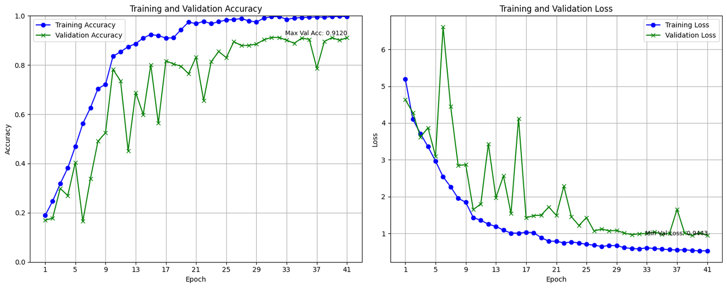
Adapted ResNet18 with L2
31x31 image size
Increased max validation accuracy (91.2%), same as VGG with L2
Validation accuracy more volatile than VGG with L2
Converges faster than VGG with L2

Slide 22
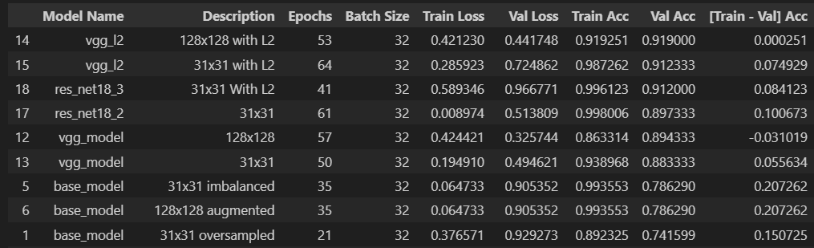
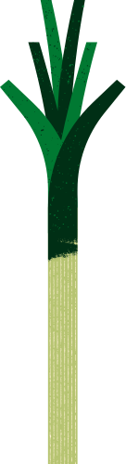
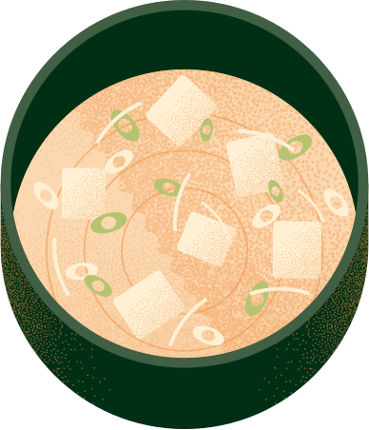
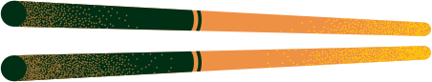
Model Selection
VGG with L2 achieved the highest validation accuracy for both 128x128 and 31x31 image sizes

Slide 23
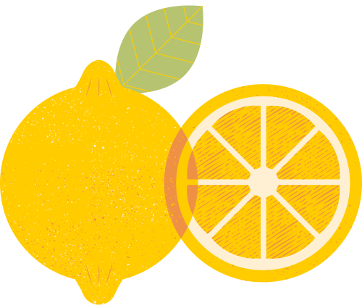
Model Improvement
Keras Tuner
10 Trials
20 epochs each
Number of Convolutional Blocks
Number of Filters per Convolutional Block
Kernel Size in Convolutional Layers
Batch Normalization
Number of Dense Layers
Units in Dense Layers
Activation Function in Dense Layers
L2 Regularization in Dense Layers
Dropout Rate
Optimizer Type
Learning Rate

Slide 24
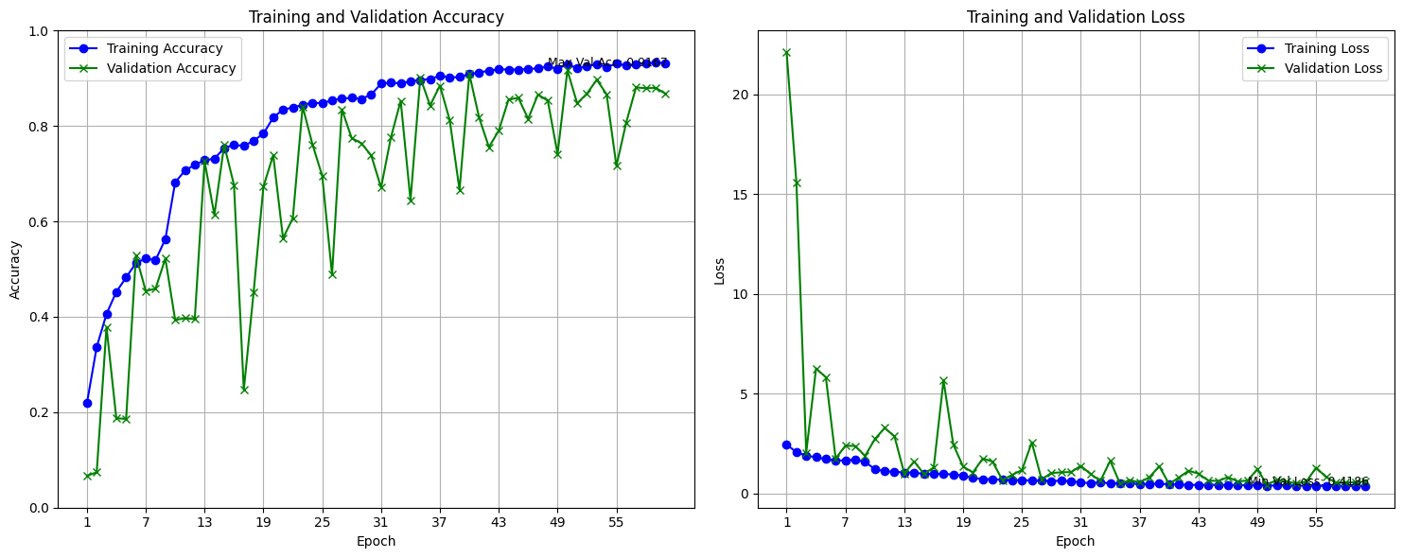
Best 128x128 model
Results from hyperparameter tuning did not achieve better results
Retrained model from earlier
Evaluation on the test set yielded an accuracy of 91.8%

Slide 25
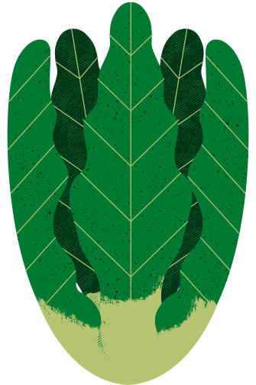

Model Evaluation
Best 128x128 model
Precision scores differ in different classes. Lowest being 0.81 for class 5 (Cabbage)
Recall scores are commendable
Stong f1 score

Slide 26

Best 31x31 model
Evaluation on the test set yielded an accuracy of 88.9%

Slide 27

Model Evaluation
Best 31x31 model
Consistent performance with precision, recall, f1 around 0.89 to 0.90
Class 11 (Potato), low precision, possible false positives
Classes 11 and 14 (Tomato) exhibit lower f1-scores

Slide 28



Thank you

